Slide 1
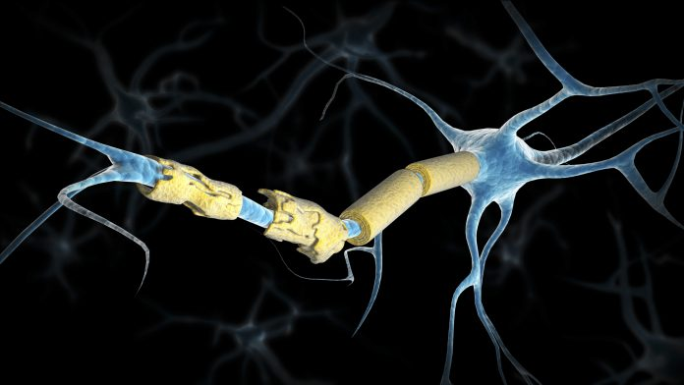
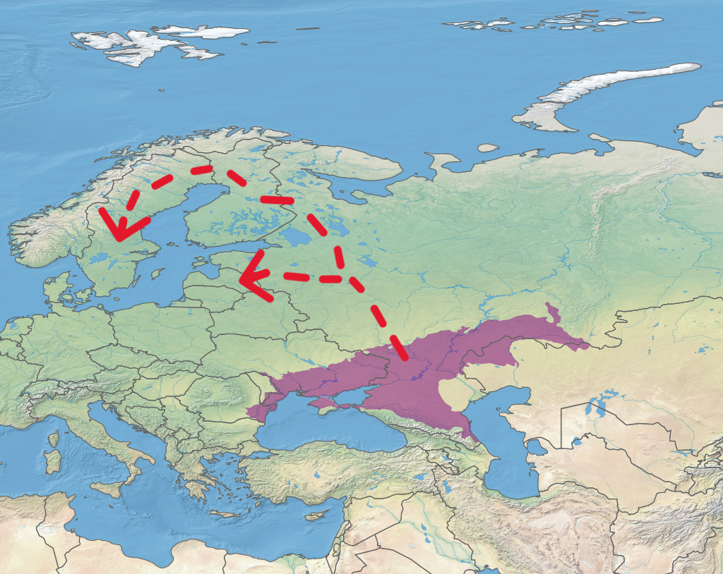

Pontic Steppe Dispersal
It was found by comparing sequenced ancient DNA with a database of modern DNA samples that people with Pontic Steppe ancestry were most at risk for carrying genes linked with multiple sclerosis. The movement of ancient pastoralists from the steppe into Northern Europe has a resulted in an increased risk of MS in the region.
It was also found that the genes conferring the increased risk were likely selected for due to links with advantageous genes that increased pathogen resistance. These genes would have been crucial in the new pastoralist lifestyle. People in Northern Europe would have had increased exposure to animals and their parasites/diseases. Without knowledge of the ancient dispersal, the history of this genetic disorder would remain unknown and those susceptible would not be informed of the risks they may face.
Around 5kya pastoralists from the Pontic steppe dispersed into Northern Europe.
Terpsichores / Tom Patterson / US National Park Service
Stocktrek Images/Getty Images
Multiple Sclerosis (MS) is an autoimmune disease affecting the brain and spinal cord. MS is thought to occur as a result of both gene-gene and gene-environment interactions.
An overactive immune response causes damage to the myelin sheath of neurons in the spine and brain.
As a result, signals along the spine are disrupted leading to issues with vision, cognitive difficulties and muscle weakness.
Barrie, W. et al. (2024) ‘Elevated genetic risk for multiple sclerosis emerged in steppe pastoralist populations’, Nature, 625(7994), pp. 321–328. doi:10.1038/s41586-023-06618-z.
Attfield, K.E. et al. (2022) ‘The Immunology of Multiple Sclerosis’, Nature Reviews Immunology, 22(12), pp. 734–750. doi:10.1038/s41577-022-00718-z.
Times / ALAMY Stock

